Slide 1
INVESTIGATING FUNCTIONS WITH MANIPULATE
Name : Prakriti Raturi
Roll No. : MAT/19/95

Slide 2
The Manipulate command is used to manipulate an expression in real time using the mouse. One of the most basic uses of Manipulate is to evaluate a function defined over an interval.

Slide 7
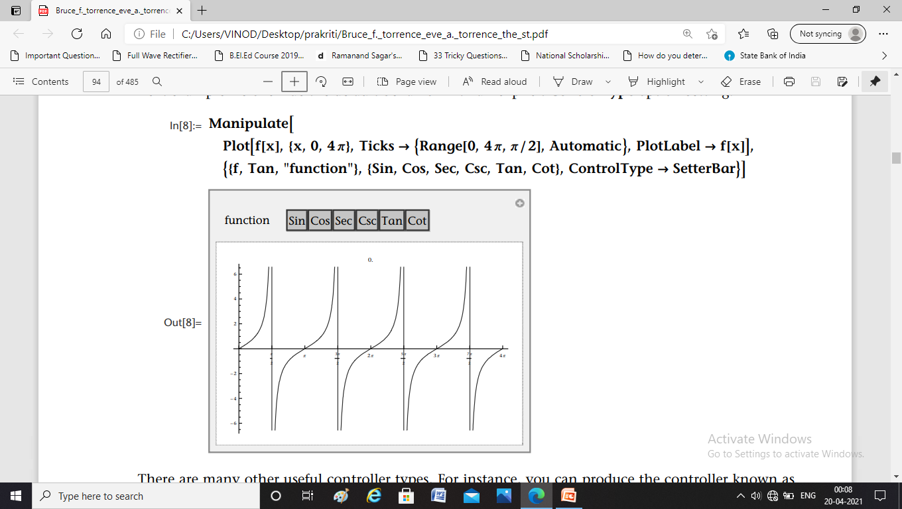

Slide 8
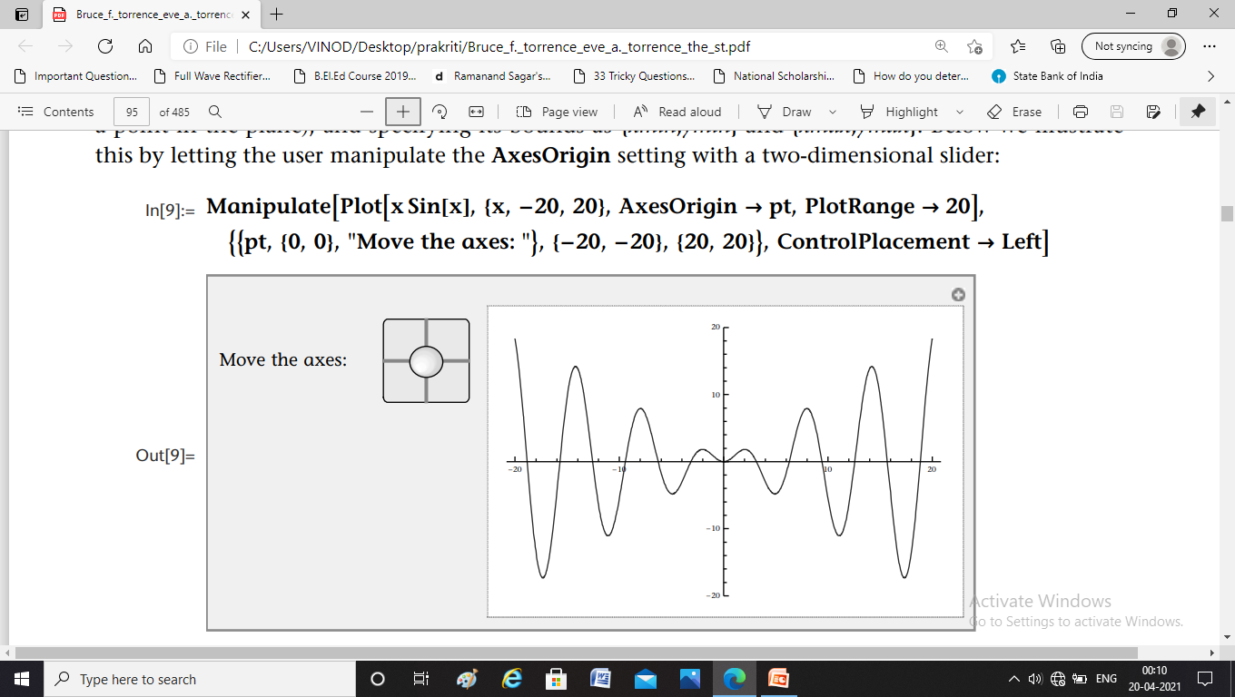

Slide 11
link to the nb file thank you

