Slide 1
ADVERTISING ASSIGNMENT
By :
Tannya Malhotra bcp/15/017

Slide 2
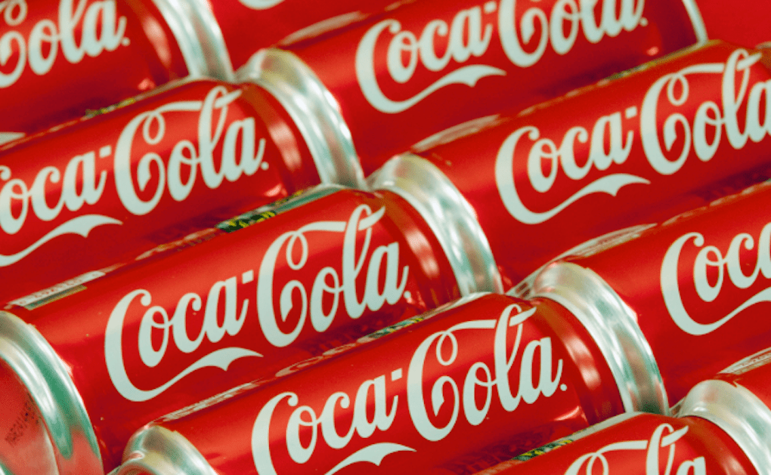
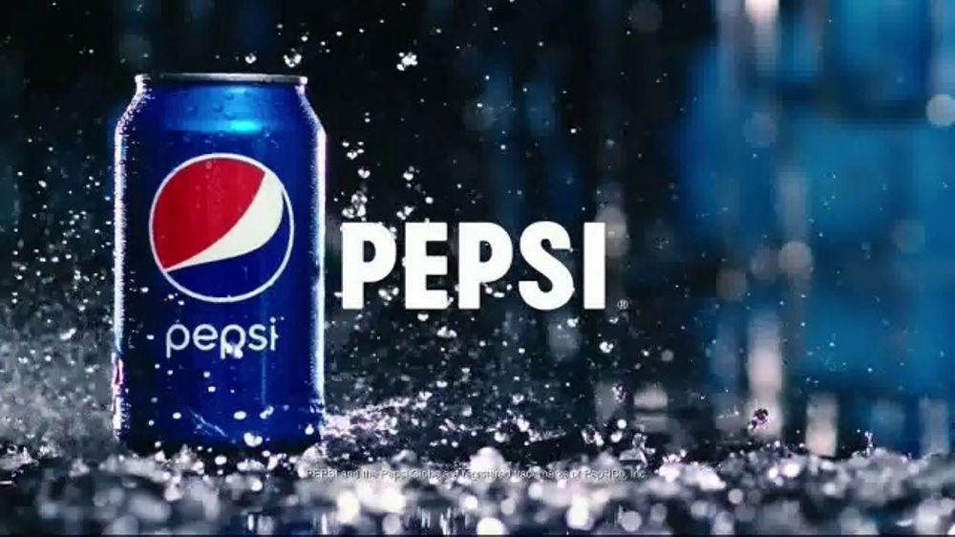
TWO COMPETITIVE PRODUCTS
COCA-COLA PEPSI

Slide 3
COCA-COLA
Coca Cola is one of the two leading brands in the soda industry and the largest brand of non-alcoholic beverages in the world. The international empire of Coca Cola spans more than 200 countries. The company has a large product portfolio of sparkling and still beverages. Apart from the large market share, Coca Cola is known for its strong brand image and high customer loyalty. It invests a very large sum each year in marketing and promotion for growing brand recognition and customer engagement. In recent years, it has focused on optimizing its product mix to cater to the changing taste of consumers worldwide.
Due to being affordable, the Coca Cola products are not targeted at a specific class of consumers. However, it is mainly the modern, young, and fun-loving youth that form the target market of Coca Cola. The soft drink brand has selected to position itself as a brand for the youth mainly. It has positioned itself as a brand that stands for youth, freedom, and happiness.

Slide 4
MARKETING STRATEGIES OF COCA-COLA
Market segmentation-Coca Cola used this technique to segment the market according to emerging markets, developing markets and developed markets since every country in the 200 plus countries play a crucial role in the growth. In emerging markets, the primary focus was on increasing the sales volume rather than profits so that it increased its customer domains and make a strong foundation for future business. This was made possible by selling beverages at economical rates so that higher no. of masses can enjoy it.
Brand establishment and Customer relationship-Coca Cola made a right decision to invest in developing the brand value by improving and modernising the advertisements by investing over $250 million. These ads focused on creating an impact upon people and changed the perspective of Coca Cola from an occasional drink to an integral part of people’s life.
Investment in CSR-Coca Cola is investing a lot in CSR and sustainability and developing a sustainable supply chain and manufacturing network. Investing in socially beneficial projects has proved beneficial for the company and has strengthened its image in the market.
Social Media-Apart from TV ads and outdoor ad campaigns, the company serves its ads across the internet and on social media. Its social media accounts are used to connect with its fans and followers and for customer engagement. There are more than 1,250 promotional videos of Coca Cola on its official YouTube channel. As competition has kept intensifying in the soda industry, companies are focusing more than ever on their social image and reputation.

Slide 5
Suggestions for Improvements
Replacement to alcohol drinks- Coca Cola can plan to launch a new sub brand focusing on this topic which has the potential to have high demands and also create a good image among the public. Although there are few pharmaceutical products which provide similar medical help, Coca Cola can use its brand name and its unique way to market its product.
Use of purified sea water for Coca Cola drinks- Coca Cola and other beverage companies have been often severely criticized for using tremendous amount of groundwater in their factories which resulted in scarcity of drinking water to the people. Coca Cola can either try to replenish the used qty after use or use a sea water purification technique with a one-time investment.
Development in purified water system-Kenley is a sub brand of Coca Cola, but the sales are not good in mineral water category. Bisleri had already created the brand name in the mineral water section so much so that its name was used as equivalent to purified water bottles by the people. Coca Cola can tie-up with such distributors and make deals so that promotion of Kenley increases among the public.

Slide 6
PEPSI
Pepsi is a carbonated soft drink manufactured by PepsiCo. There is no person in the world who doesn’t know Pepsi because it is one of the top 50 brands in the world. In 1893 Caleb Bradham, a pharmacist from North Carolina, began experimenting with non-alcoholic drinks. His beverage was called Brad's drink and it was elaborated with carbonated water, sugar, vanilla, oils, pepsin and cola nuts. Pepsi goes always together with marketing and advertising strategies to try to distance itself from his first and major rival, Coca Cola. Throughout its history it has turned into one of the brands that invest more in advertising, image, packaging, etcetera. At this moment it is one of the most consumed brands worldwide and has a turnover of 30 billion dollars and more than 480 thousand employees. Bottles, cans and logo are always submitted to different changes promoting different events around the world.

Slide 7
MARKETING STRATEGIES OF PEPSI
Position yourself well- As a brand, Pepsi has positioned itself as one that embodies young energy, and this can be seen throughout their marketing and advertising campaigns. Pepsi’s customers are mainly aged between 13 and 35 years old from lower middle class to upper class with a busy and modern lifestyle. Their prices reflect that, staying affordable for millennials from different classes. They have even released smaller soft drinks options to make their products more appealing to those who need a quick drink to satiate their thirst and cravings.
Invest in the right channels-According to Pepsi’s annual report, though, they increased their global marketing and advertising budget by more than 12% for 2019. A lot of this now goes into digital marketing and advertising. Although Pepsi still spends on traditional advertising methods like television advertising, a lot has changed through the years. With digital technology still on the rise, it would be smart to invest more in digital marketing as Pepsi does.
Focus on digital marketing- As important as it is to connect with customers online, it also essential to have a good digital marketing strategy in place. One reason why Pepsi is still top of mind is that their digital campaigns always make a mark on their target market. Their 20-minute long ‘Bring Home Happiness’ campaign, for example, became so viral that people watched it more than a billion times.
Be innovative-Pepsi also continues to invest in the packaging and quality of their products to stay top of mind. They have also expanded their product offerings by adding more nutritious options for their health-conscious consumers. Updating their designs regularly has helped keep their customers happy while drawing in new ones at the same time. They do this because they know that attractive packages and having more options can help drive more sales. People’s needs change regularly, after all, so adapting to those needs is one important thing that Pepsi focuses on.

Slide 8
SUGGESTIONS FOR IMPROVEMENT
Pepsi should do collaborative marketing with some companies which are playing major role in house hold distribution.
Delicacy Problems should be removed.
Increase in Profit and scheme for the retailers.
Available the flavors in the peak season when it is demanded.
Pepsi should hire women to advertise cold drink.

Slide 9
SWOT ANALYSIS
 | COCA-COLA | PEPSI
STRENGTHS | FIRST MOVER ADVANTAGE. MORE LOYAL CUSTOMER BASE. INTERNATIONAL BRAND RECOGNITION. HUGE DISTRIBUTION NETWORK. EFFICIENT DIVERSE GLOBAL OPERATIONS. | GUERRILLA MARKETING STRATEGIES. MORE FOCUS ON YOUNG GENERATION. INTERNATIONAL BRAND RECOGNITION. HUGE DISTRIBUTION NETWORK. MORE FLEXIBLE FRANCHISE NETWORK.
WEAKNESSES | MOVING AWAY FROM CORE COMPETENCIES. BRAND FAILURES PRODUCT RECALLS | SMALLER MARKET THAN COKE. SLOWER TAKE OFF IN INTERNATIONAL MARKETS. IMITATION OF COCA-COLA.
OPPORTUNITIES | ENTRY INTO NEW DEVELOPING INTERNATIONAL MARKETINGS. INTRODUCTION OF NEWER BRANDS. INNOVATIVE ADVERTISING STRATEGIES. | INTRODUCTION OF “PEPSI HEALTH DRINK”. ENTRY NEW DEVELOPING INTERNATIONAL. INTRODUCTION OF NEWER BRANDS.
THREATS | FEAR OF LOSING MARKET SHARE DUE TO RAPID MARKET FLUCTUATIONS. BARRIERS OF ENTRY IN INTERNATIONAL MARKETS. NEW AGE BEVERAGES. | FEAR OF LOSING MARKET SHARE DUE TO RAPID MARKET FLUCTUATIONS. BARRIERS OF ENTRY IN INTERNATIONAL MARKETS. NEW AGE BEVERAGES.

Slide 10
THANK YOU

