Slide 1
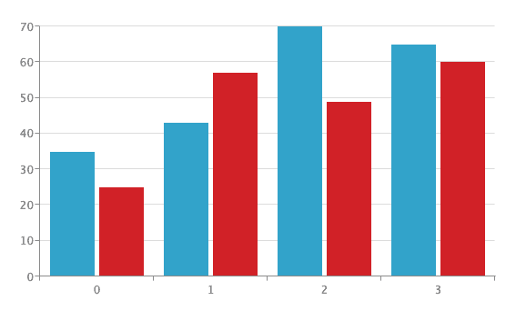
BAR CHARTS
Presented by –
* Muskan Kaur(MAT/19/56)
* Palak Kathuria(MAT/19/10)

Slide 2
INTRODUCTION:
*A bar chart or bar graph is a chart or graph that presents categorical data with rectangular bars with heights or lengths proportional to the values that they represent. The bars can be plotted vertically or horizontally. A vertical bar chart is sometimes called a column chart.
* Bar Charts are widely used because they convey information in a readily understood fashion. It shows data that falls into discrete categories.

Slide 3
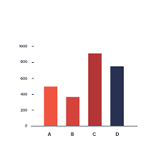
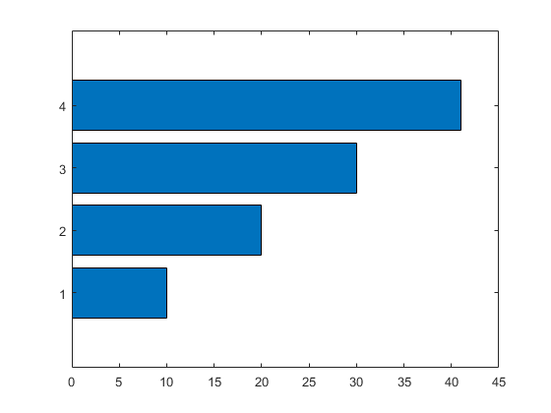
TYPES OF BARCHARTS
THERE ARE TWO TYPES OF BARCHARTS :
VERTICAL BAR CHART
HORIZONTAL BAR CHART

Slide 4
VERTICAL BAR CHART:
A graph that visually displays data using vertical bars going up from the bottom, whose lengths are proportional to quantities they represent. It can be used when one axis cannot have a numerical scale.

Slide 5
THERE ARE FURTHER MORE TYPES OF VERTICAL BAR CHARTS:
1.VERTICAL STACKED BAR CHART
2. GROUPED VERTICAL BAR CHART
3. SEGMENTED VERTICAL BAR CHART

Slide 6
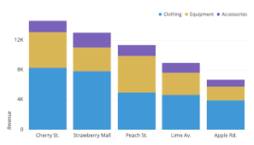
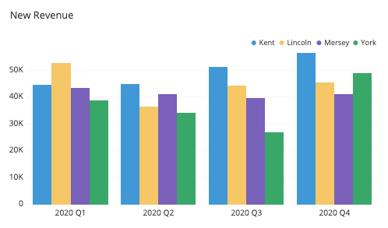
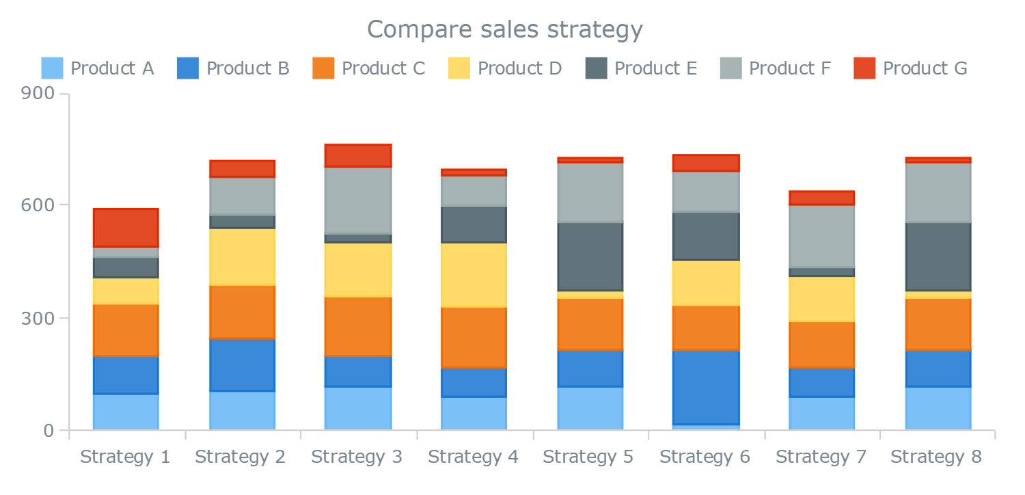
VERTICAL STACKED BAR CHART:
Use a vertical stacked bar chart when you want to view information for one dimension within another dimension.
. GROUPED VERTICAL BAR CHART:
A grouped bar chart is a type of bar graph that is used to represent and compare different categories of two or more groups.
SEGMENTED VERTICAL BAR CHART:
The stacked bar chart has become quite popular; it is used for grouping or categorizing the parts of a whole.

Slide 7
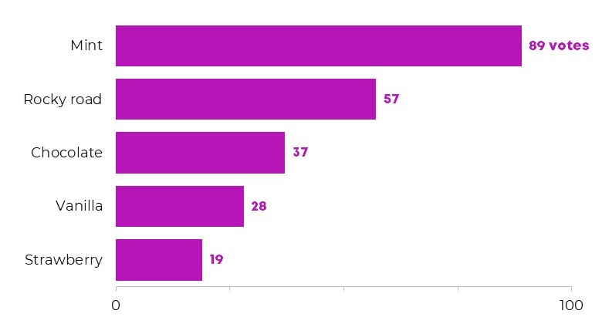
HORIZONTAL BAR CHARTS:
Horizontal bar graphs represent the data horizontally. It is a graph whose bars are drawn horizontally. The data categories are shown on the vertical axis and the data values are shown on the horizontal axis.

Slide 8
HERE ARE SOME TYPES OF HORIZONTAL BAR CHARTS:
HORIZONTAL STACKED BAR CHART
HORIZONTAL GROUPED BAR CHART
SEGMENTED HORIZONTAL BAR CHART

Slide 9
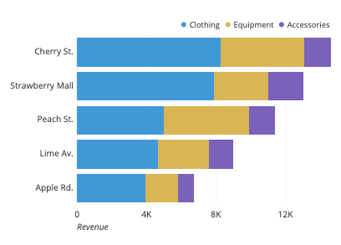
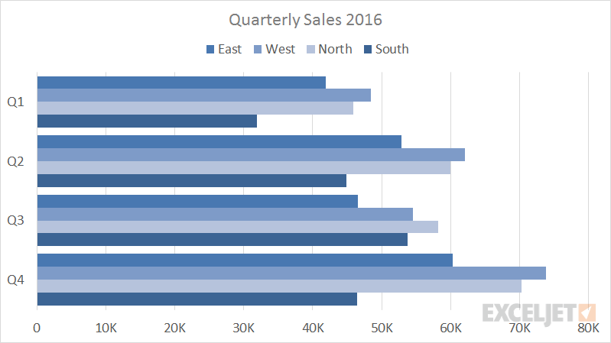
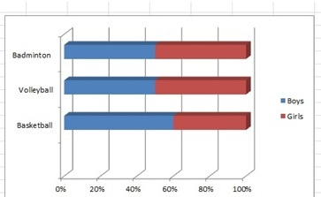
HORIZONTAL STACKED BAR CHART:
Horizontal bar graphs represent the data horizontally. It is a graph whose bars are drawn horizontally.
2. HORIZONTAL GROUPED BAR CHART:
It is a graph whose bars are drawn horizontally. The data categories are shown on the vertical axis and the data values are shown on the horizontal axis.
SEGMENTED HORIZONTAL BAR CHART:
A segmented Bar chart is one kind of stacked bar chart, but each bar will show 100% of the discrete value.

Slide 10
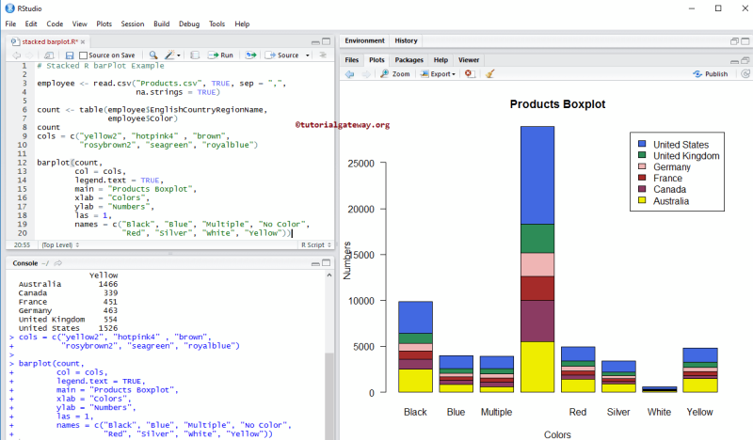
How to make a bar chart in “R” SOFTWARE?
-> R uses the function barplot( ) to create bar charts . R can draw both vertical and horizontal bars in the bar chart.

Slide 11
EXAMPLE 1:
Consider a matrix as follows:
Garden <-c(47,19,50,46,9,4)
Hedgerow<-c(10,3,0,16,3,0)
Parkland<-c(40,5,10,8,0,6)
Pasture<-c(2,0,7,4,0,0)
Woodland<-c(2,2,0,0,2,0)
m<-cbind(Garden, Hedgerow, Parkland, Pasture, Woodland)
[1, ] 47 10 40 2 2
[2, ] 19 3 5 0 2 [3, ] 50 0 10 7 0
[4, ] 46 16 8 4 0
[5, ] 9 3 0 0 2
[6, ] 4 0 6 0 0

Slide 12
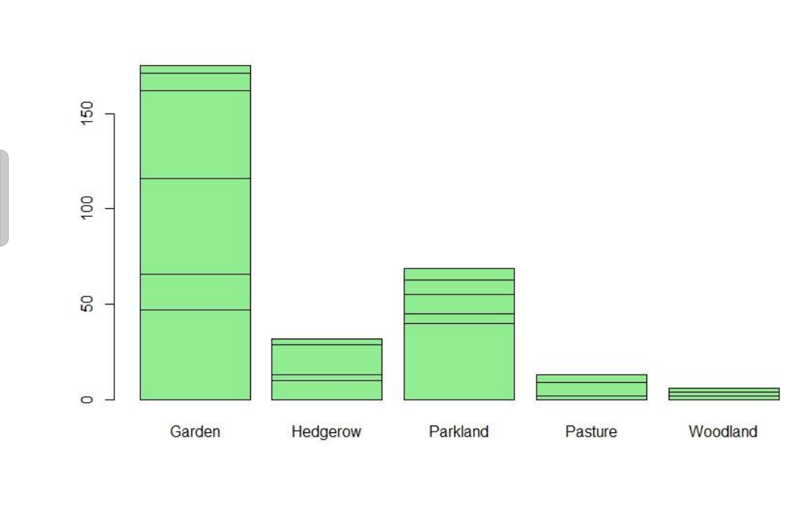
barplot (m,col=‘lightgreen’)

Slide 13
Example 2 :
Data is given in a vector form:
rain<-c(3,5,7,5,3,2,6,8,5,6,9,8)
rain
[1] 3 5 7 5 3 2 6 8 5 6 9 8
barplot(rain)
month<-c(“Jan”, “Feb” , “Mar” , “Apr” , “May”, “June” , “July” , ”Aug”, “Sep” , “Oct”, “Nov”, “Dec”)
barplot(rain, names=month, xlab=‘Month’, ylab=‘rain’ , col=‘red’)

Slide 14
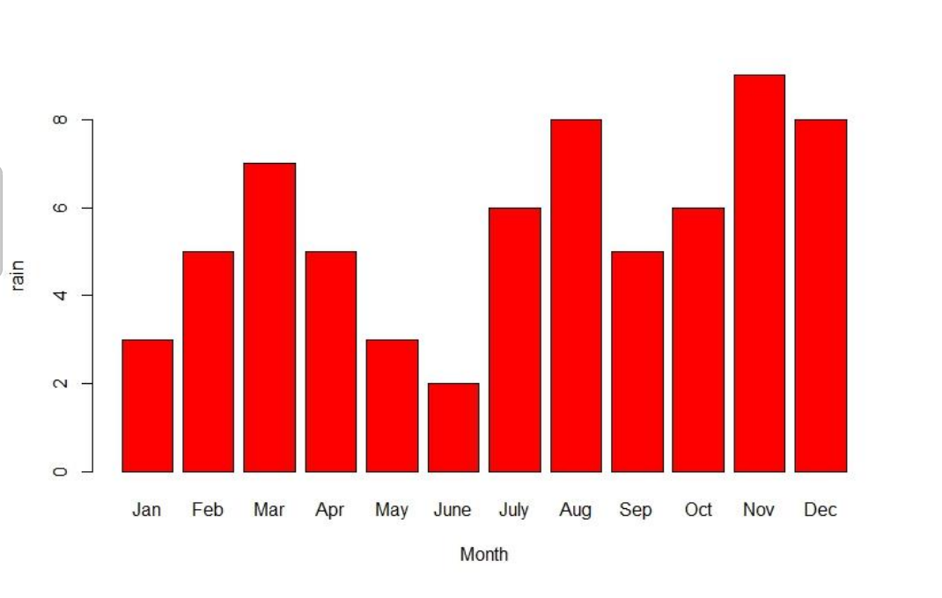

Slide 15
* T.H.A.N.K. Y.O.U *

