Slide 1
MEXICO
Presented by:
SIMRAN KAUR
HARNOOR KAUR
SUSHMEET KAUR
DIVYANSHI KOHLI

Slide 3
MEXICO
Mexico is a country between the U.S and Central America that’s known for its Pacific and Gulf of Mexico beaches and its diverse landscape of mountains , deserts and jungles.
Mexico is the located in the “Ring of Fire,’’ one of the earth’s most violent earthquake and volcano zones.
Mexico city has the highest elevation and is oldest city in North America. It is also one of the largest country in the world.

Slide 4
FACTS
The official name of for Mexico is the United Mexican States.
Mexico is the 11th most populated country in the world
There are 31 states in Mexico as well as the capital city (Mexico City).
The highest mountain in Mexico is Pico de Orizaba
The national symbol of Mexico is the golden eagle which features prominently on the coat of arms.
Mexican food is known for its range of flavours and spices. Popular dishes include tacos, burritos and enchiladas

Slide 5
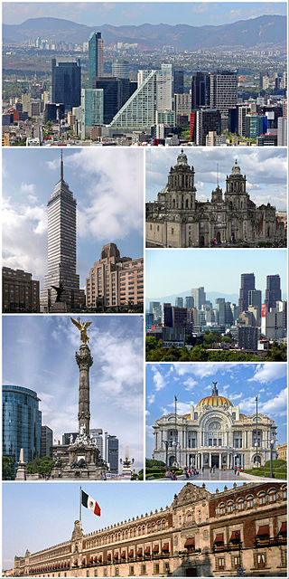
MEXICO CITY

Slide 6
MEXICO CITY
Mexico City, or the City of Mexico is the capital and most populous city of Mexico
As an "alpha" global city Mexico City is one of the most important financial centers in the America
It is located in the Valley of Mexico
The city consists of sixteen municipalities

Slide 7
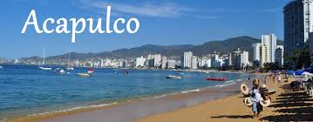

Slide 8
Acapulco is considered the country’s 16th largest Metropolitian area and one of the most important destinations since Golden days in the 1950’s
Glamorous ,Spontaneous and Splashy ,Acapulco is a city that invites superlatives.
Acapulco, the Pacific Ocean, famous for its beautiful & dazzling nightlife.
It has remained as Mexico’s tourist destination, preferred by National and International visitors.

Slide 9
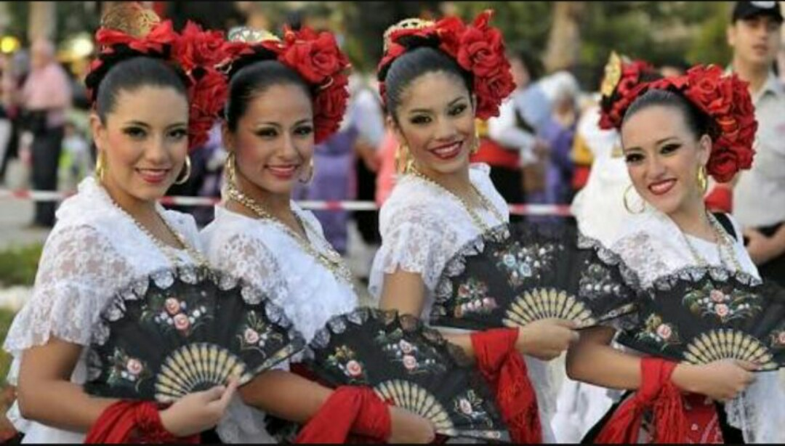
CULTURE
The culture of Mexico reflects the country’s complex history.
The culture at developed in Mexico became one of the cradles of civilization.
Roman Catholics became the main religion of Mexico
In many ways, contemporary life in the cities of Mexico has become similar to that in neighboring U.S and Europe .

Slide 10
CLIMATE
The climate of Mexico is highly varied.
Temperature here remain high throughout the year.
The optimum time to visit is generally between DECEMBER to APRIL, when there is virtually no rain.
The coolest months are between DECEMBER and FEBRUARY while the wet season begins in the south in MAY and lasts until OCTOBER.

Slide 11
VISITING MEXICO IN JANUARY – FEBRUARY
Dry season across most of Mexico.
Warm months across the country.
Ideal for exploring or for time on the beach.

Slide 12
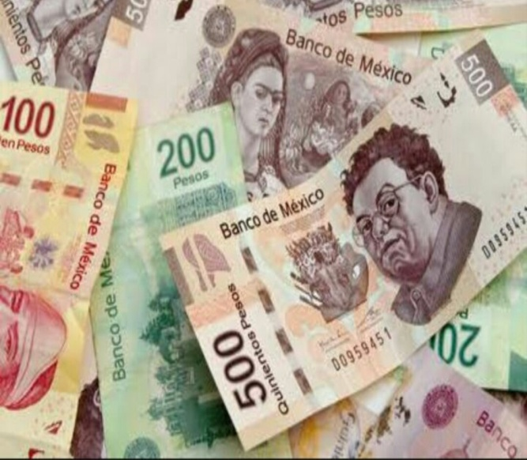
CURRENCY
MEXICAN PESO
As one of the oldest currencies in north America, the original Mexican Peso followed the design of the Spanish Sihar dollar and eight-piece
LANGUAGE
Main language – SPANISH
Minority language – Catalan, Chipilo, Venetian dialect
Immigrant language -- English

Slide 13
MEXICAN CUISINES
The basic staples remain native food such as Corn,beans and Chilli peppers. The most important of which were meat from domesticated animals ,dairy products and various herbs and lots of species.
Famous Cuisines
Pozole – Pre-Hispanic Soup
Tacos al pastor– Historic dish of tacos
Chiles en Nogada– Patriotic dish
Elote – Corn
Mole – a rice sauce
Guacamole – side dish
Tamales – corn dough with fillings
Tostadas – toasted dish

Slide 14
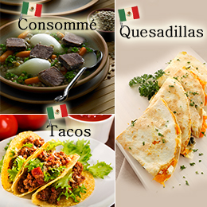

Slide 15
ACCESSIBILITY

Slide 16
One can reach MEXICO by flight Benito juarez airport
Both airport terminals have a number of elevators ,ramps, and electric walkways.
Terminal 1 in the domestic and international departure areas and the domestic car park
Terminal 2 in the departure lounges and the car park

Slide 17
ACCOMODATIONS

Slide 18
3 STAR HOTEL
Zocalo Central Hotel
Location: Centro Historico
Amenities: Free wi-fi,
Free breakfast, Laundry service, Room service, Kid-friendly, Restaurant.

Slide 19
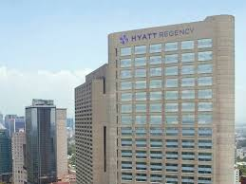
4 Star Hotel
JM Marriott Hotel
Location: Polanco
Amenities: Laundry service,room service,kid-friendly,hot tub,spa
HYATT REGENCY
Location: Polanco Chaputtepec
Amenities: Free breakfast,restaurant,fitness centre

Slide 20
5 Star Hotel
GRAND VELAS RIVIERA NAYARIT
Location: Puerto vallarta coast
Amenities: Room service,restaurant,fitness centre, outdoor pool, free parking
FOUR SEASONS RESORT
Location:: Puta Mita
Amenities: Free wifi , free parking, outdoor pool,fitness centre

Slide 21
ATTRACTIONS

Slide 22
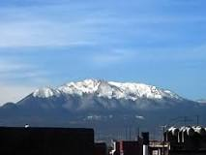
Must Visit Places in MEXICO CITY!
1.AJUSCO
Ajusco is a 3,930 m lava dome volcano located just south of Mexico City, Mexico. It is the highest point in the Mexican Federal District.

Slide 23
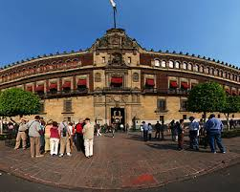
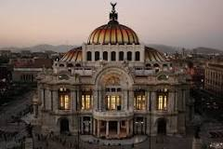
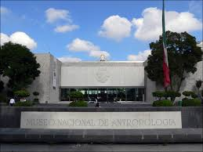
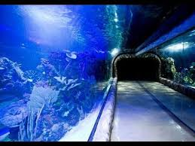
3. THE NATIONAL PALACE
The National Palace is the seat of the federal executive in Mexico. It is located on Mexico City's main square
2. THE HISTORIC CENTER.
The historic center of Mexico City, also known as the Centro or Centro Histórico, is the central neighborhood in Mexico City.
5. ACUARIO INBURSA.
The Acuario Inbursa is an aquarium, Mexico City. It is the largest in Mexico with 3500 square meters of exhibition space and 1.6 million liters of ocean water.
4. The National Museum
The National Museum of Anthropology is a national museum of Mexico. It is the largest and most visited museum in Mexico.

Slide 24
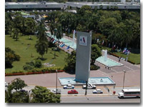
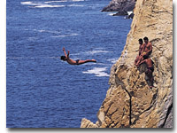
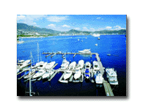
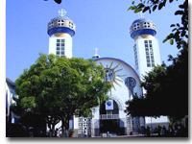
Best places to be visited in Acapulco !
2. La Quebrada
La Quebrada is perhaps Acapulco's most iconic attraction, a place that has come to symbolize the city itself
3. La Marina Acapulco This huge development was built to satisfy the demand for sea-going service. It is primarily designed for weekend tourists.
1.Convention Centre
A busy place where conventions take place, large television shows are staged and taped
4. The Cathedral
This church is a perfect example of Acapulco's rich history with Spanish, Moorish and native influences.

Slide 25
AMENITIES

Slide 26
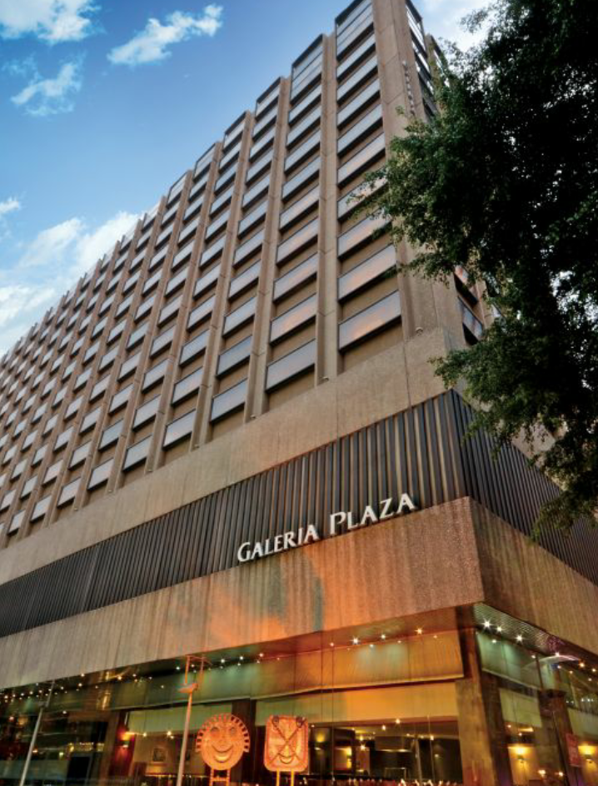
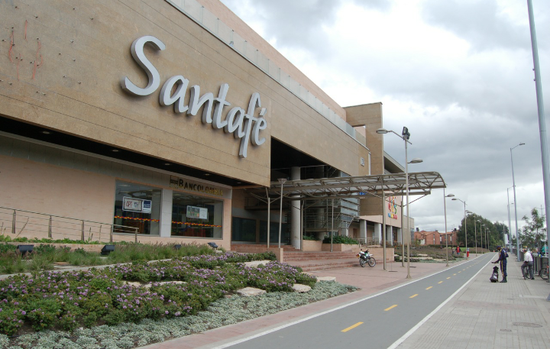
Famous malls
Centro Santa Fe
Plaza kukulcan
Gleria plaza
hilton

Slide 27
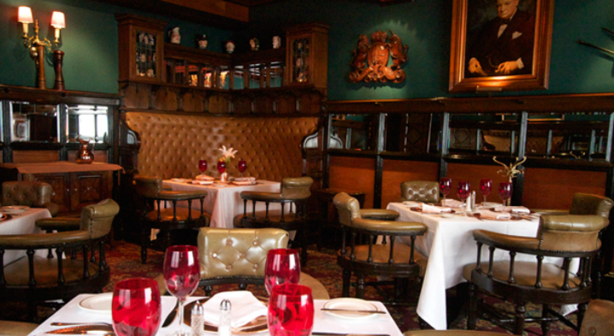
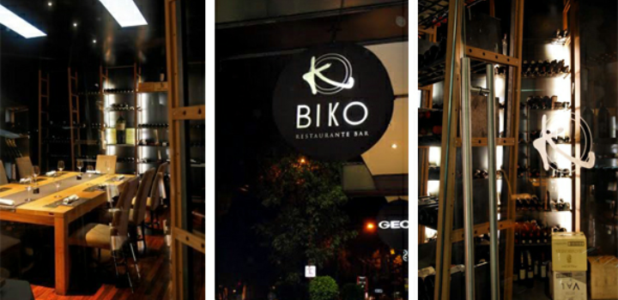
Famous restaurants
danubia
Mercado roma
Sir Winston Curcills
BIKO

Slide 28
ACTIVITIES

Slide 29
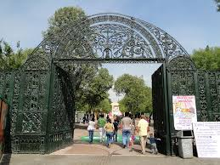
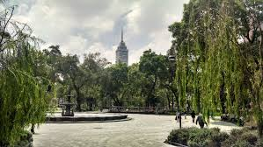
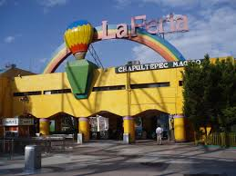
2. Chapultepec Zoo
Chapultepec Zoo is a zoo located in Chapultepec Park; it is one of four zoos near Mexico City, and the best known Mexican zoo
ALAMEDA CENTRAL
Alameda Central is a public municipal park in downtown Mexico City.
3. La Feria Chapultepec Mágico
La Feria Chapultepec Mágico is an amusement park in Mexico City,

Slide 30
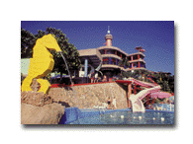
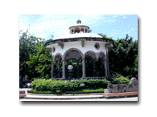
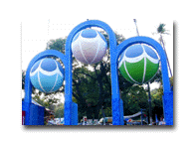
Activities in Acapulco !!
1. Aca Zoo Modern zoo located in the Roqueta Island where you may observe many animal species. It has a children playground, food court and swimming facilities.
3. Magico Mundo Marino Between the beaches Caleta and Caletilla is the new Mágico Mundo Marino, an aquarium, which has indoor and outdoor marine exhibits, as well as pools, two water slides, restaurant. It is a great place for family fun
4. The Zocalo The main public plaza in town. This is a center of family activity and strolling about especially on Sundays.
2. Papagayo Park This is one of the best municipal parks in Mexico, a downtown garden area totaling 52 acres and filled with exotic birds.

Slide 31
THANKYOU

